Slide 1

Cogno Web Obervatory
Implementation Document

Slide 2
Components
Dashboard
Dialog-example
Graph
Icons
Admin-layout
Login
Map
Maps
Model

Slide 3
Components cont.
Notifications
Register
Table-list
Trendtopic
Typography
Upgrade
User-profile
Wishlist
Components
  Footer
  Navbar
  sidebar

Slide 4
Not Useful Components
Icons : Given by google as we have used google icons
Model : Created by mistake ( I Think )
Notifications : Provided by material as learning resource of notification
Typography : Again by material for better typographic elements such as heading, para , text ( Learning Resource )
User Profile : Looks like we are taking log of user activity
Upgrade : Given by material UI for there promotion

Slide 5
Services
Alert service
Auth-guard
Auth
Customer
Data-utils
Name
Update

Slide 6
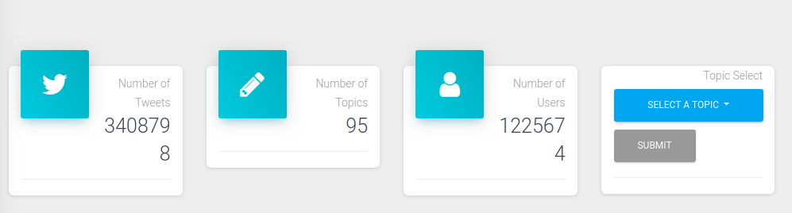
Dashboard
Used Services : Data-utils,name,example

Slide 7
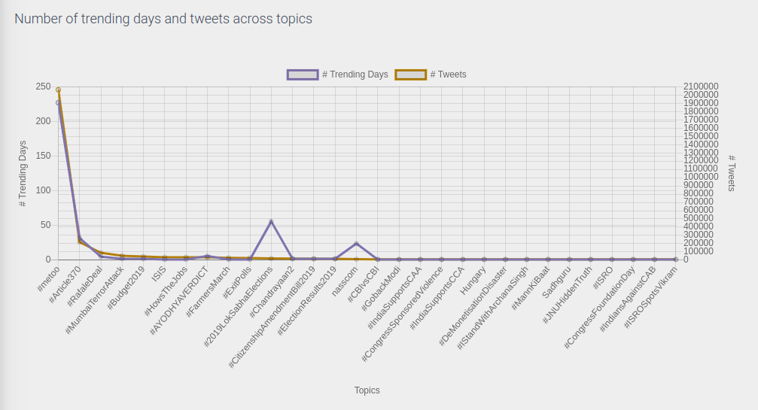
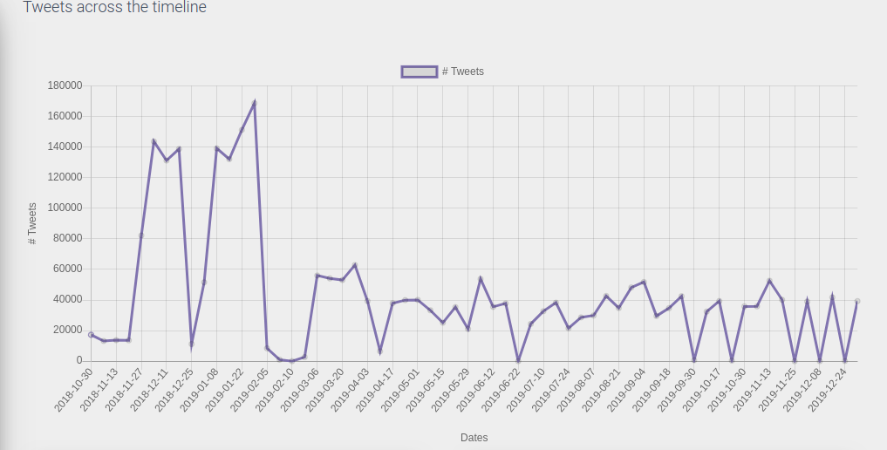

Slide 8
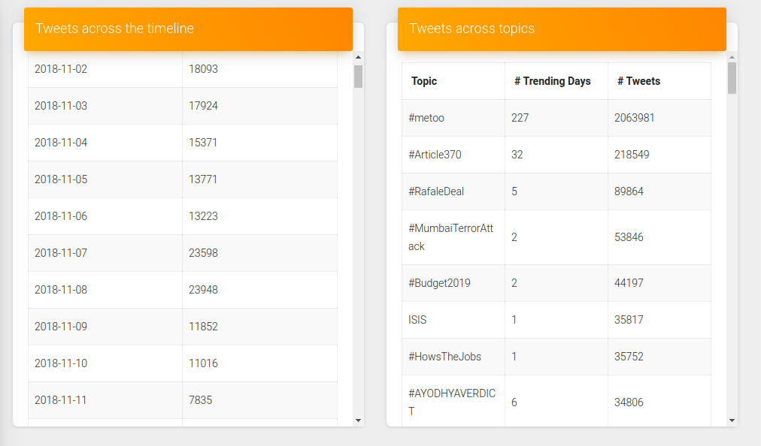

Slide 9
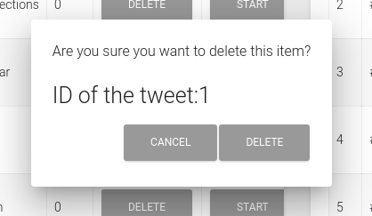
Dialog-example

Slide 10
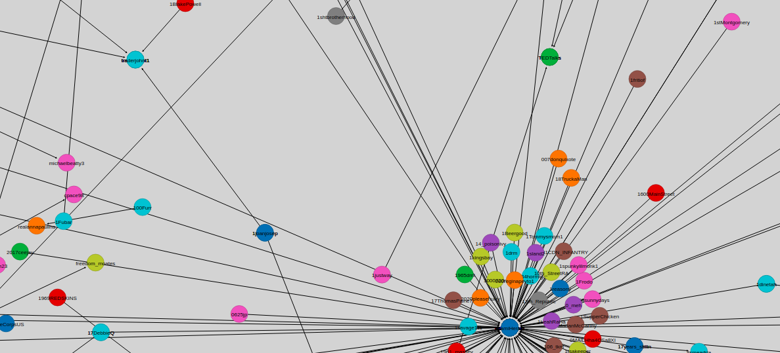
Graph

Slide 11
Admin-layout
Invokes
  Navbar
  Footer
  Sidebar

Slide 12
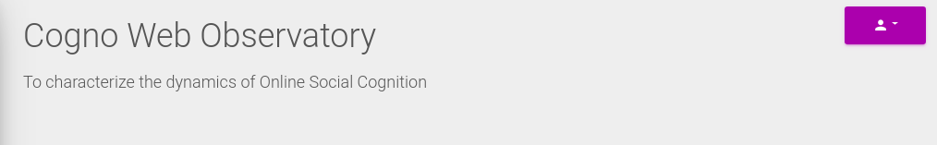
Navbar
Footer

Slide 13
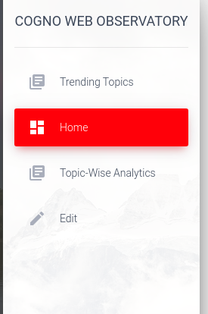
sidebar

Slide 14
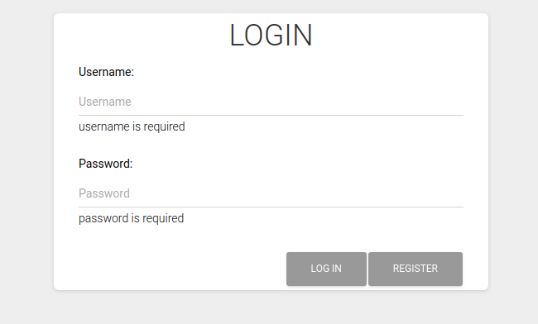
Login
Ps : Update in UI required

Slide 15
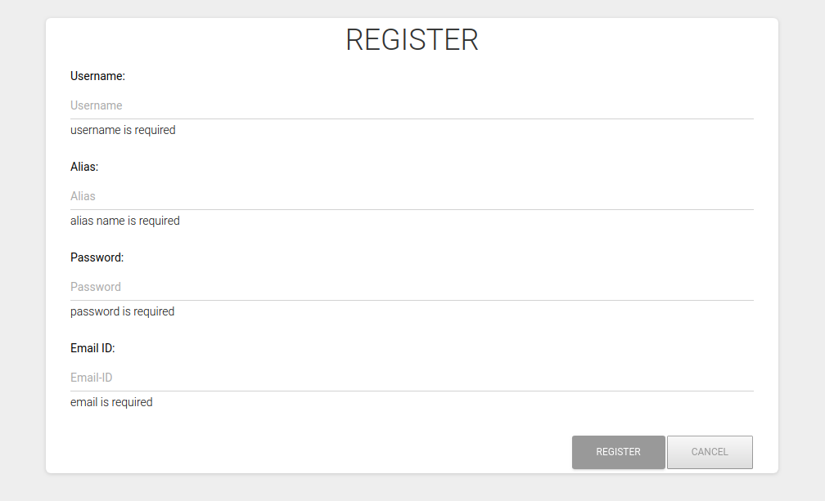
Register
Ps : Update in UI required

Slide 16
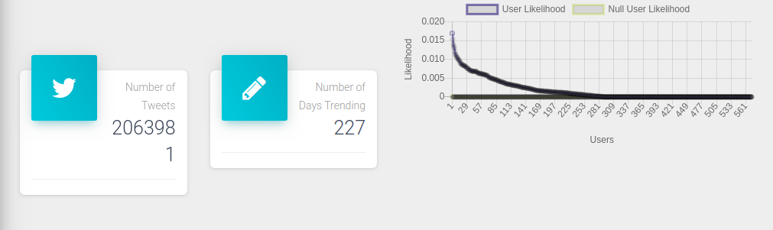
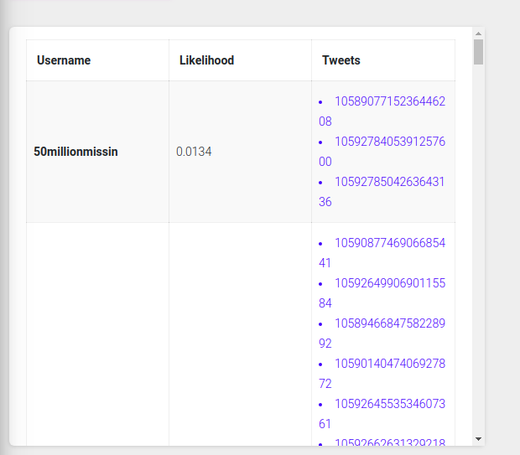
Table List

Slide 17
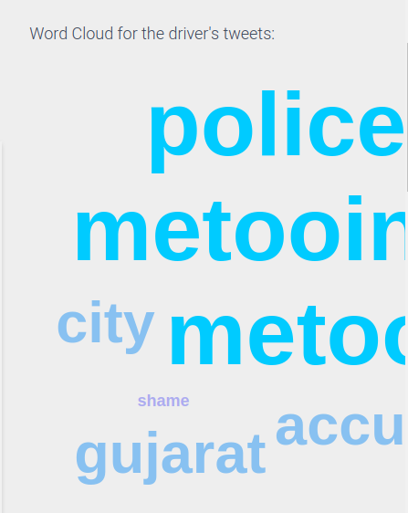

Slide 18
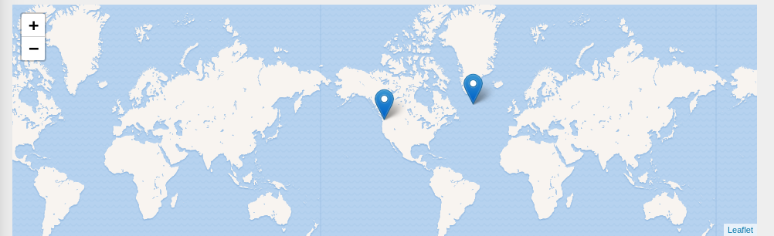
Leaflet is Javascript library for Interatice maps
Currently Points shown are hardcoded

Slide 19
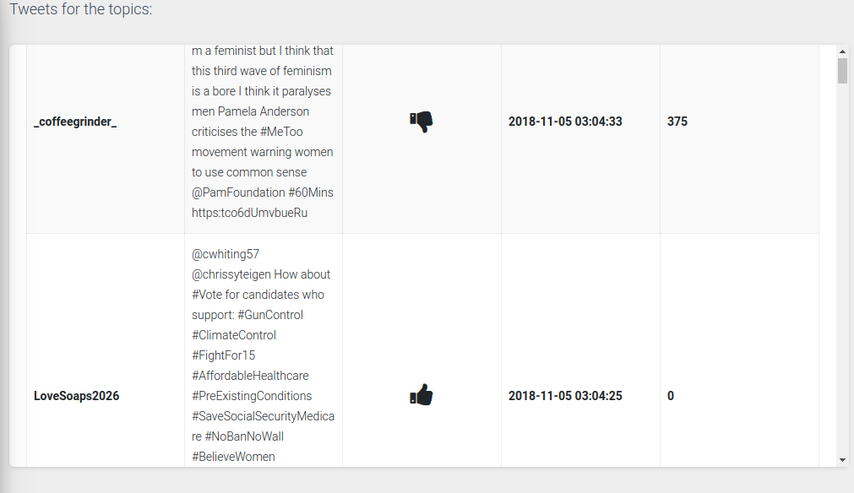
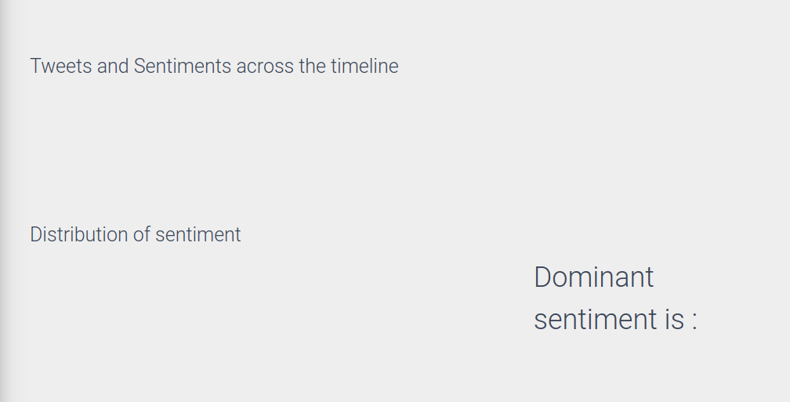

Slide 20
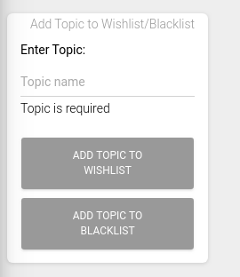
WishList
Invokes : Name Service for adding topic into wishlist or blacklist

Slide 21
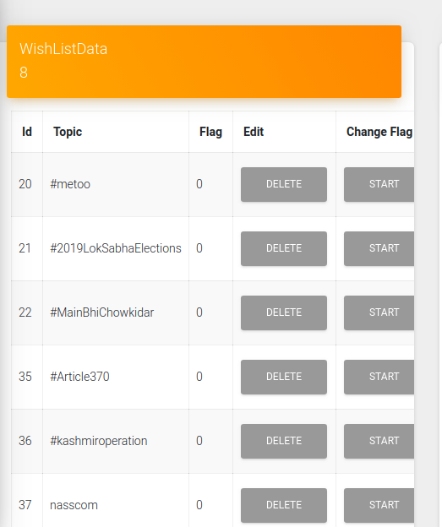
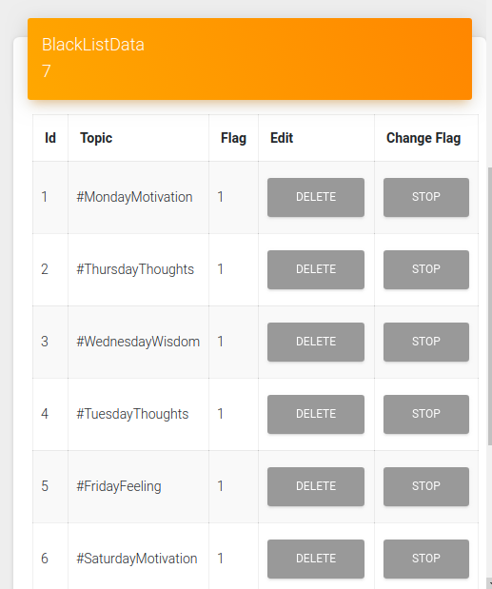
Invokes : Update Service for changing flag and Delete Events

Slide 22
Name Service
Adding data to wishlist and retriving topics of wishlist
Adding data to blacklist and retriving topics of blacklist

Slide 23
Customer Service
Responsible for login and registry
Communicate with auth.php, which serves as a server.

Slide 24
Update Service
It is invoked when we delete some top from wishlist or blacklist or we change the flag value .

Slide 25
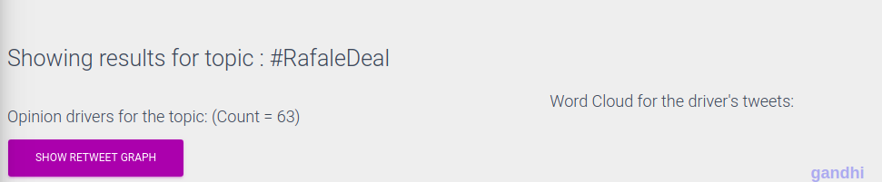
Task 3 – To Display Topic name

Slide 26
Thanks
Kavish Agnihotri
MT2019052

